Slide 1
Unit 4
Disk performance optimization and File Systems

Slide 2
Syllabus
Disk performance optimization: Disk Hardware, Disk Formatting, Disk Arm Scheduling Algorithms, Error Handling.
File Systems: Files, Directories, File-System Layout, Implementing Files, Implementing Directories.

Slide 3
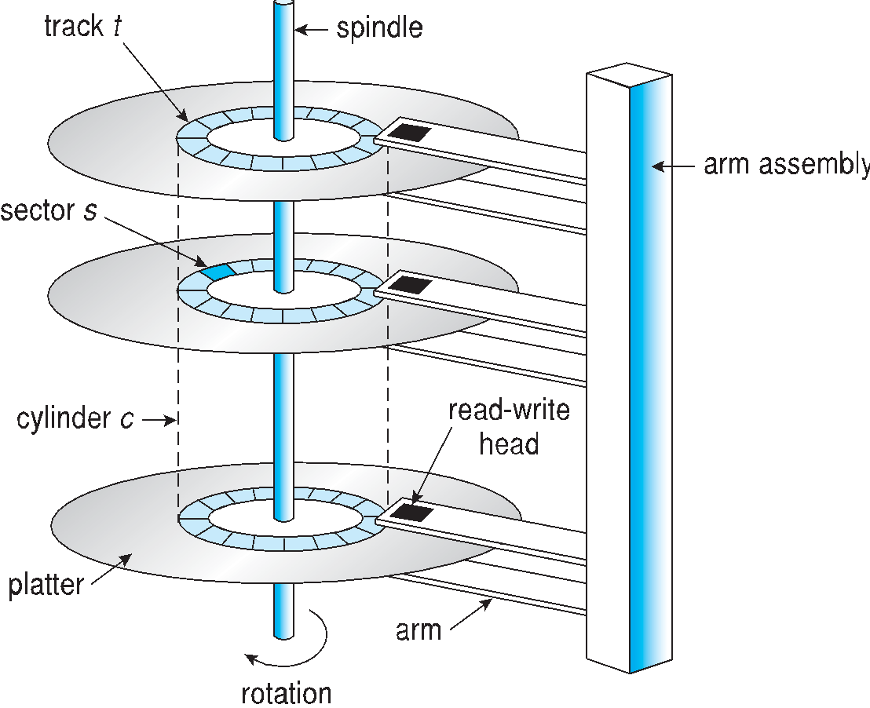
Disk Hardware

Slide 4
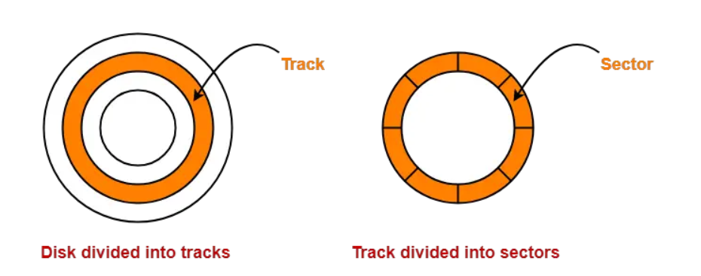
Magnetic Disk in Computer Architecture-
Magnetic disk is a storage device that is used to write, rewrite and access data.
It uses a magnetization process.
The entire disk is divided into platters.
Each platter consists of concentric circles called as tracks.
These tracks are further divided into sectors which are the smallest divisions in the disk.

Slide 5
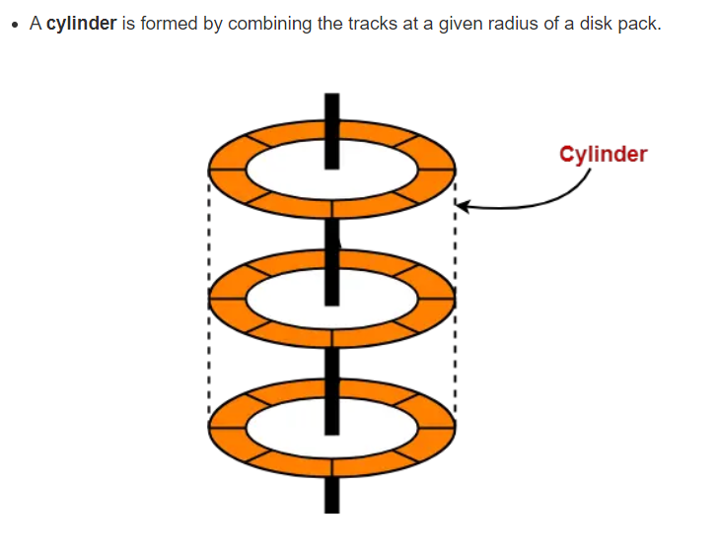
There exists a mechanical arm called as Read / Write head.
It is used to read from and write to the disk.
Head has to reach at a particular track and then wait for the rotation of the platter.
The rotation causes the required sector of the track to come under the head.
Each platter has 2 surfaces- top and bottom and both the surfaces are used to store the data.
Each surface has its own read / write head.

Slide 6
Disk Hardware
Assume we have a hard disk with the following characteristics:
Number of platters: 2
Number of surfaces per platter: 2 (upper and lower)
Number of tracks per surface: 200
Number of sectors per track: 50
Size of each sector: 512 bytes
Find the disk size in terms of KB, MB, and GB?

Slide 7
Disk Hardware
Identify the total number of tracks:
Total tracks = Number of platters × Number of surfaces per platter × Number of tracks per surface Total tracks = 2 × 2 × 200 = 800 tracks
2. Calculate the total number of sectors:
Total sectors = Total tracks × Number of sectors per track Total sectors
= 800 × 50 = 40,000 sectors
3. Calculate the total storage capacity:
Total storage capacity = Total sectors × Size of each sector Total storage capacity
= 40,000 × 512 bytes = 20,480,000 bytes

Slide 8
Disk Hardware
Types of disc hardware:
Magnetic disks
RAID
CD-ROM
CD-Recordable
CD-Rewritable
DVD

Slide 9
Magnetic Disks
The magnetic discs are organized into cylinders, and each cylinder has a number of tracks equal to the number of heads that are stacked vertically above it. And the tracks are separated into their respective sectors.
RAID
"Redundant Array of Inexpensive Disks". Installing a box full of discs next to the computer, which is typically a large server, then replacing the disc controller card with a RAID controller, copying the data over to the RAID, and then continuing with the normal operation is the fundamental concept behind the technology known as RAID, which stands for redundant array of inexpensive discs.
In other words, you could say that RAID appears to the operating system to be an SLED, which stands for "single large expensive disc." However, RAID outperforms SLED both in terms of performance and reliability.
CD-ROM
In the year 1980, two major companies, namely Philips and Sony, collaborated on the development of the compact disc (CD), which quickly replaced the 33 1/3 rpm vinyl record as the primary medium for storing and playing music.
All of the compact discs have a diameter of 120 millimetres, a thickness of 1.2 millimetres, and a hole measuring 15 millimetres in the centre of the disc.
Now, almost four years later, in the year 1984, these two companies realised the power and potential of using compact discs to store computer data; as a result, they developed CD-ROM, which stands for Compact Disk-Read Only Memory. CD-ROM is an abbreviation for "Compact Disk-Read Only Memory."

Slide 10
CD-Recordable
Physically, CD-Recordable (CD-R) stars are similar to CD-ROMs in that they are made of 120mm polycarbonate blanks; however, unlike CD-ROMs, CD-R stars contain a groove that is 0.6mm wide to direct the laser during the writing process.
CD-Rewritable
CD-ReWritable (CD-RW) is a technology that was developed in response to public demand for a rewritable CD-ROM. This technology uses media of the same size as CD-Recordable (CD-R), and it was given the acronym CD-RW (CD-R).
However, the recording layer of a CD-RW is made from an alloy that consists of silver, antimony, indium, and tellurium.
DVD
DVD stands for "digital video disc" or "digital versatile disc." The general layout of a DVD is comparable to that of a CD; both formats make use of injection-molded polycarbonate discs measuring 120 millimetres in diameter and containing pits and lands that are illuminated by a laser diode and read by a photodetector.

Slide 11
Disk Formatting
Disk formatting is a process to configure the data-storage devices such as hard-drive, floppy disk and flash drive when we are going to use them for the very first time or we can say initial usage.
Disk formatting is usually required when new operating system is going to be used by the user.
It is also done when there is space issue and we require additional space for the storage of more data in the drives.
When we format the disk then the existing files within the disk is also erased.
When we are going to use hard-drive for initial use it is going to search for virus. It can scan for virus and repair the bad sectors within the drive.
Disk formatting has also the capability to erase the bad applications and various sophisticated viruses.
We must have the backup of all the data and applications which we require.
No-doubt disk formatting requires time.
But the frequent formatting of the disk decreases the life of the hard-drive.

Slide 12
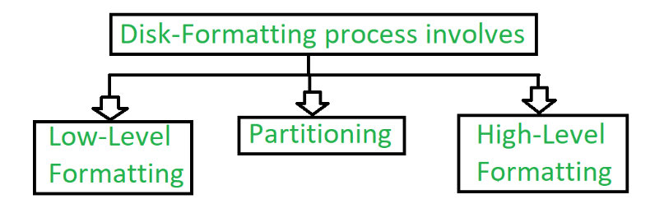
Disk Formatting

Slide 13
Low-level Formatting :
Low level formatting is a type of physical formatting. It is the process of marking of cylinders and tracks of the blank hard-disk. After this there is the division of tracks into sectors with the sector markers. Now-a-days low-level formatting is performed by the hard-disk manufactures themselves.
We have data in our hard-disk and when we perform low-level formatting in the presence of data in the hard-disk all the data have been erased and it is impossible to recover that data. Some users make such a format that they can avoid their privacy leakage. Otherwise low-level will cause damage to hard-disk shortens the service-life.
This formatting is not suggested to users.

Slide 14
2. Partitioning :
As suggesting from the name, partitioning means divisions. Partitioning is the process of dividing the hard-disk into one or more regions. The regions are called as partitions.
It can be performed by the users and it will affect the disk performance.
3. High-level Formatting :
High-level formatting is the process of writing. Writing on a file system, cluster size, partition label, and so on for a newly created partition or volume.
It is done to erase the hard-disk and again installing the operating system on the disk-drive.

Slide 15
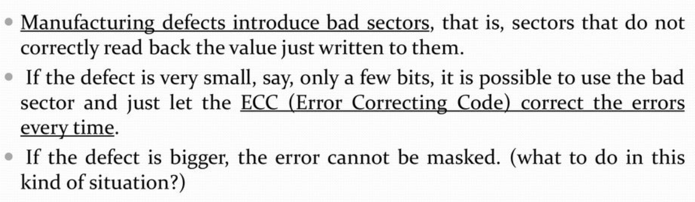
Error Handling in Disks
There are two general approaches to bad blocks:
deal with them in the controller or
deal with them in the operating

Slide 16
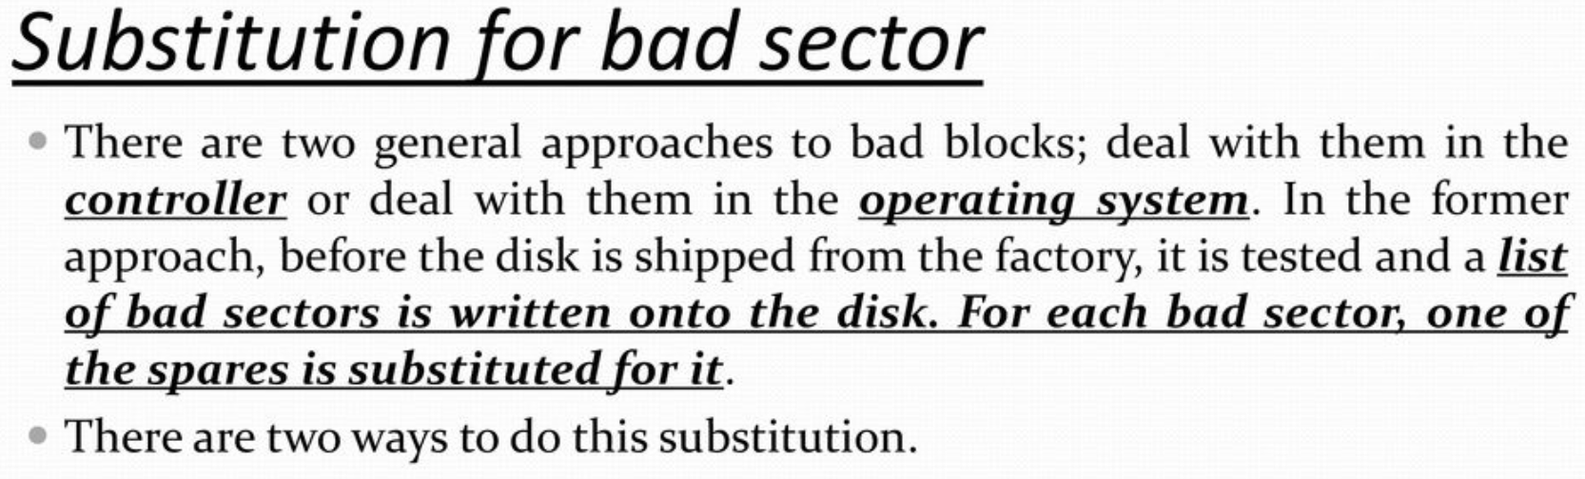
Error Handling

Slide 17
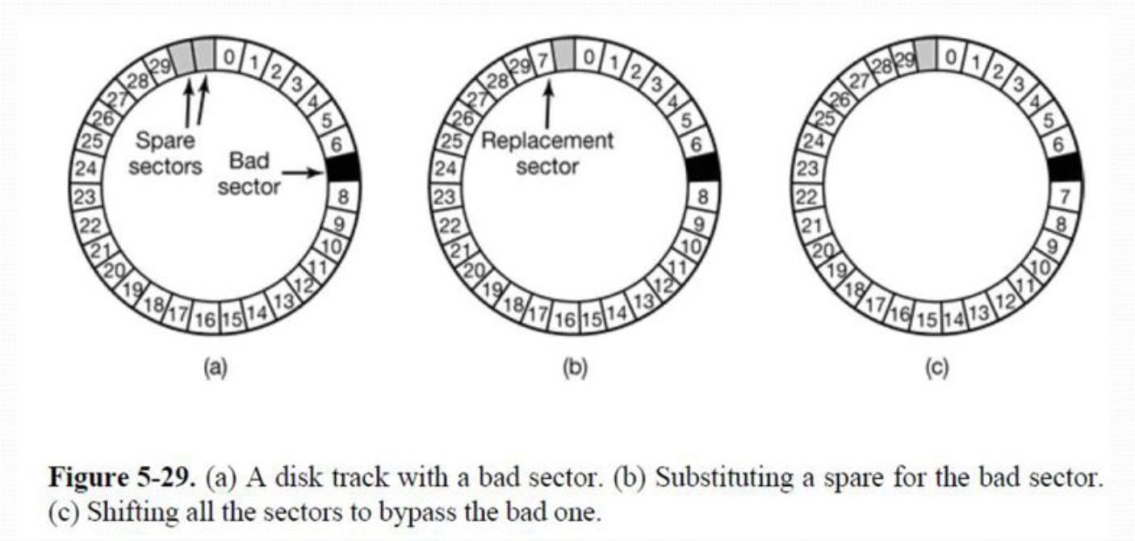
Error Handling

Slide 18
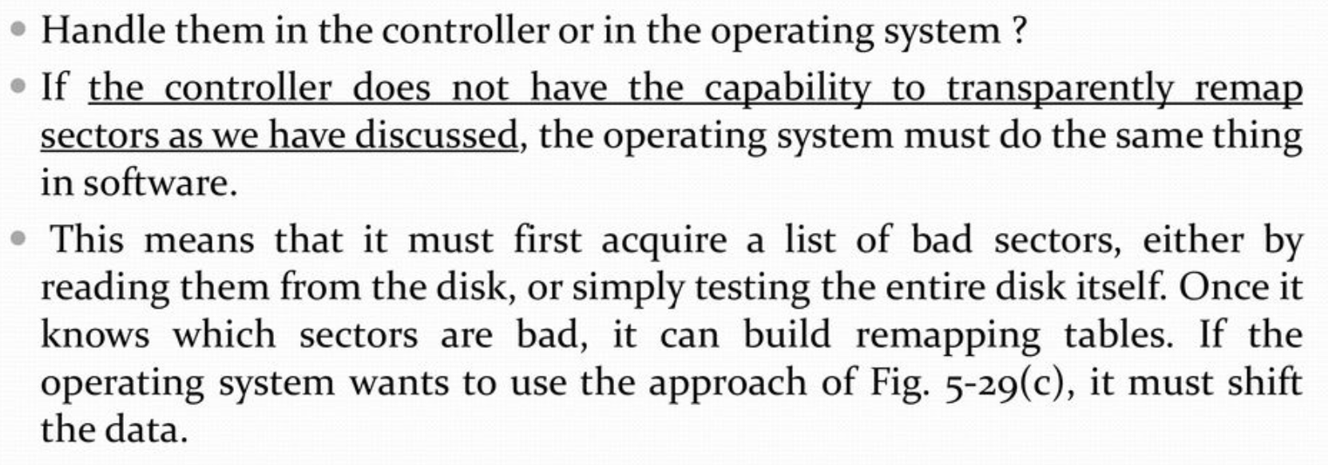
Error Handling

Slide 19
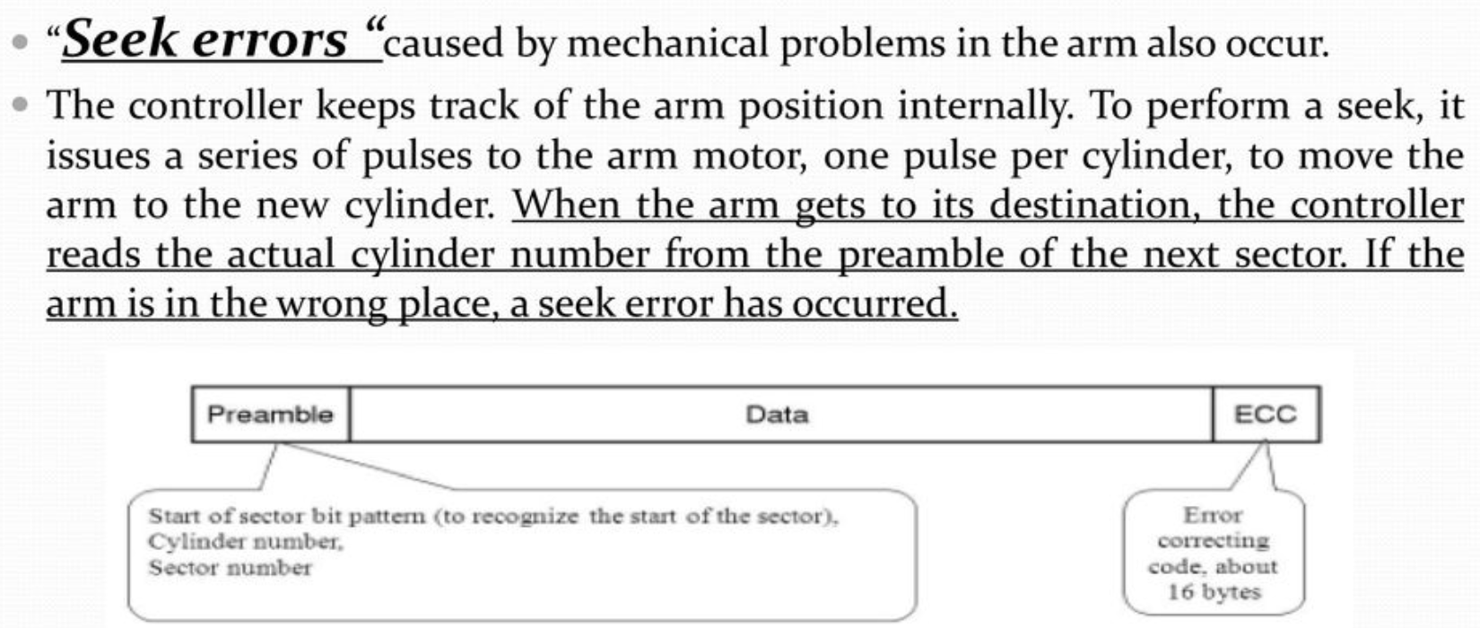
Error Handling

Slide 20
Disk arm Scheduling algorithms
Key Terms:
Seek Time: Seek time is the time taken to locate the disk arm to a specified track where the data is to be read or written. So the disk scheduling algorithm that gives a minimum average seek time is better.
Rotational Latency: Rotational Latency is the time taken by the desired sector of the disk to rotate into a position so that it can access the read/write heads. So the disk scheduling algorithm that gives minimum rotational latency is better.
Transfer Time: Transfer time is the time to transfer the data. It depends on the rotating speed of the disk and the number of bytes to be transferred.
Disk Access Time:
Disk Access Time = Seek Time + Rotational Latency + Transfer Time
Total Seek Time = Total head Movement * Seek Time

Slide 21
Seek Time-
The time taken by the read / write head to reach the desired track is called as seek time.
It is the component which contributes the largest percentage of the disk service time.
The lower the seek time, the faster the I/O operation.
The purpose of disk scheduling algorithms is to reduce the total seek time.

Slide 22
FCFS Disk Scheduling Algorithm-
As the name suggests, this algorithm entertains requests in the order they arrive in the disk queue.
It is the simplest disk scheduling algorithm.
Advantages-
It is simple, easy to understand and implement.
It does not cause starvation to any request.
Disadvantages-
It results in increased total seek time.
It is inefficient.

Slide 23
FCFS
Consider a disk queue with requests for I/O to blocks on cylinders 98, 183, 41, 122, 14, 124, 65, 67. The head is initially at cylinder number 53 moving towards larger cylinder numbers on its servicing pass. The cylinders are numbered from 0 to 199. The total head movement (in number of cylinders) incurred while servicing these requests is _______.

Slide 24
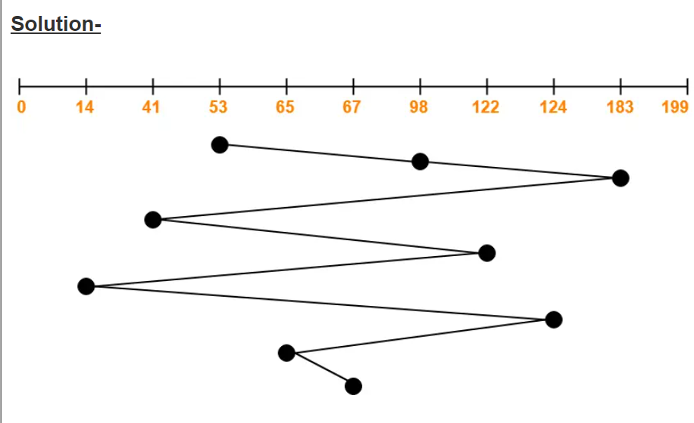
Total head movements incurred while servicing these requests
= (98 – 53) + (183 – 98) + (183 – 41) + (122 – 41) + (122 – 14) + (124 – 14) + (124 – 65) + (67 – 65)
= 45 + 85 + 142 + 81 + 108 + 110 + 59 + 2
= 632

Slide 25
SSTF Disk Scheduling Algorithm-
SSTF stands for Shortest Seek Time First.
This algorithm services that request next which requires least number of head movements from its current position regardless of the direction.
It breaks the tie in the direction of head movement.
Advantages-
It reduces the total seek time as compared to FCFS.
It provides increased throughput.
It provides less average response time and waiting time.
Disadvantages-
There is an overhead of finding out the closest request.
The requests which are far from the head might starve for the CPU.
It provides high variance in response time and waiting time.
Switching the direction of head frequently slows down the algorithm.

Slide 26
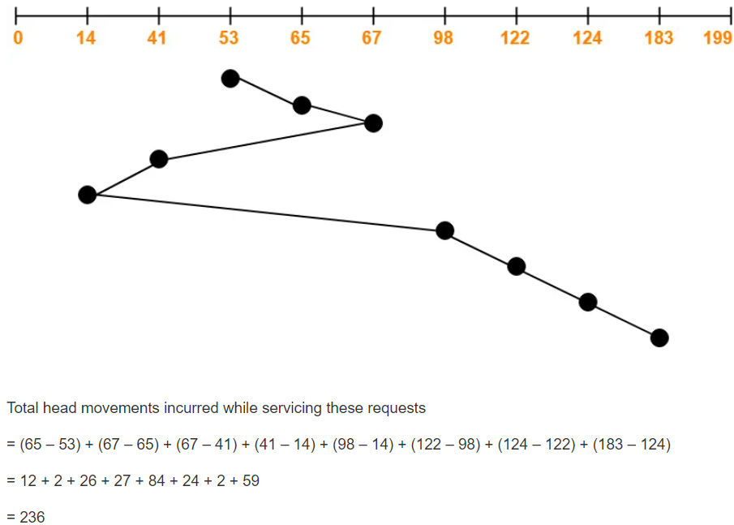
SSTF

Slide 27
SCAN Disk Scheduling Algorithm-
As the name suggests, this algorithm scans all the cylinders of the disk back and forth.
Head starts from one end of the disk and move towards the other end servicing all the requests in between.
After reaching the other end, head reverses its direction and move towards the starting end servicing all the requests in between.
The same process repeats.
SCAN Algorithm is also called as Elevator Algorithm.
This is because its working resembles the working of an elevator.

Slide 28
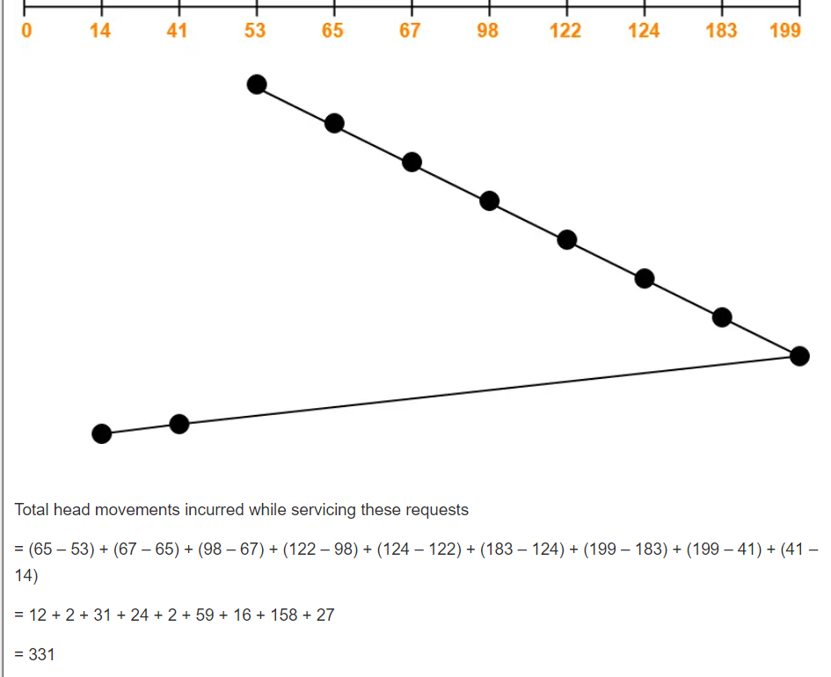

Slide 29
Advantages-
It is simple, easy to understand and implement.
It does not lead to starvation.
It provides low variance in response time and waiting time.
Disadvantages-
It causes long waiting time for the cylinders just visited by the head.
It causes the head to move till the end of the disk even if there are no requests to be serviced.

Slide 30
C-SCAN Disk Scheduling Algorithm-
Circular-SCAN Algorithm is an improved version of the SCAN Algorithm.
Head starts from one end of the disk and move towards the other end servicing all the requests in between.
After reaching the other end, head reverses its direction.
It then returns to the starting end without servicing any request in between.
The same process repeats.

Slide 31
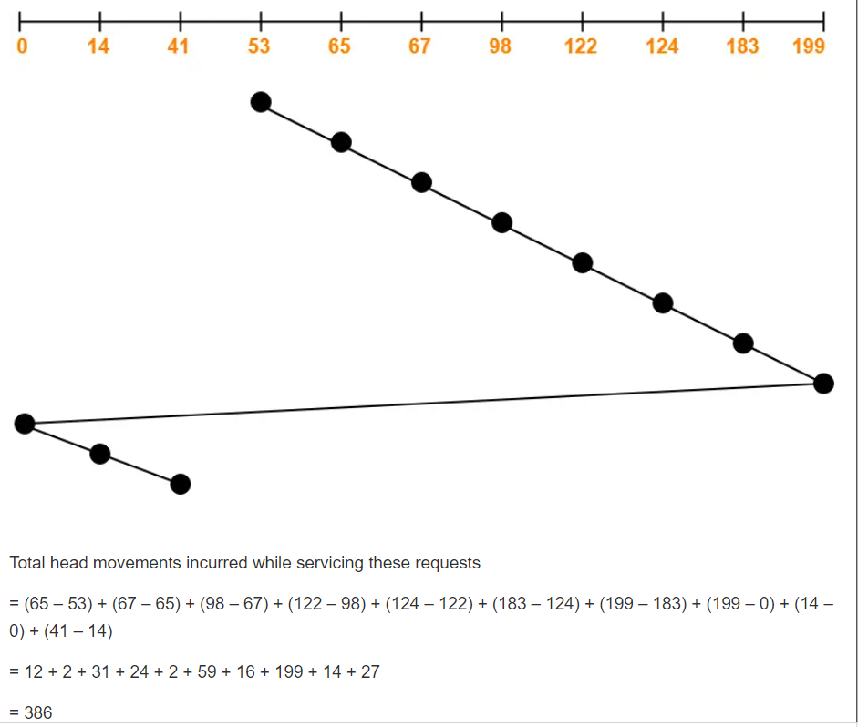

Slide 32
Advantages-
The waiting time for the cylinders just visited by the head is reduced as compared to the SCAN Algorithm.
It provides uniform waiting time.
It provides better response time.
Disadvantages-
It causes more seek movements as compared to SCAN Algorithm.
It causes the head to move till the end of the disk even if there are no requests to be serviced.

Slide 33
LOOK Disk Scheduling Algorithm-
LOOK Algorithm is an improved version of the SCAN Algorithm.
Head starts from the first request at one end of the disk and moves towards the last request at the other end servicing all the requests in between.
After reaching the last request at the other end, head reverses its direction.
It then returns to the first request at the starting end servicing all the requests in between.
The same process repeats.

Slide 34
The main difference between SCAN Algorithm and LOOK Algorithm is-
SCAN Algorithm scans all the cylinders of the disk starting from one end to the other end even if there are no requests at the ends.
LOOK Algorithm scans all the cylinders of the disk starting from the first request at one end to the last request at the other end.

Slide 35
Advantages-
It does not causes the head to move till the ends of the disk when there are no requests to be serviced.
It provides better performance as compared to SCAN Algorithm.
It does not lead to starvation.
It provides low variance in response time and waiting time.
Disadvantages-
There is an overhead of finding the end requests.
It causes long waiting time for the cylinders just visited by the head.

Slide 36
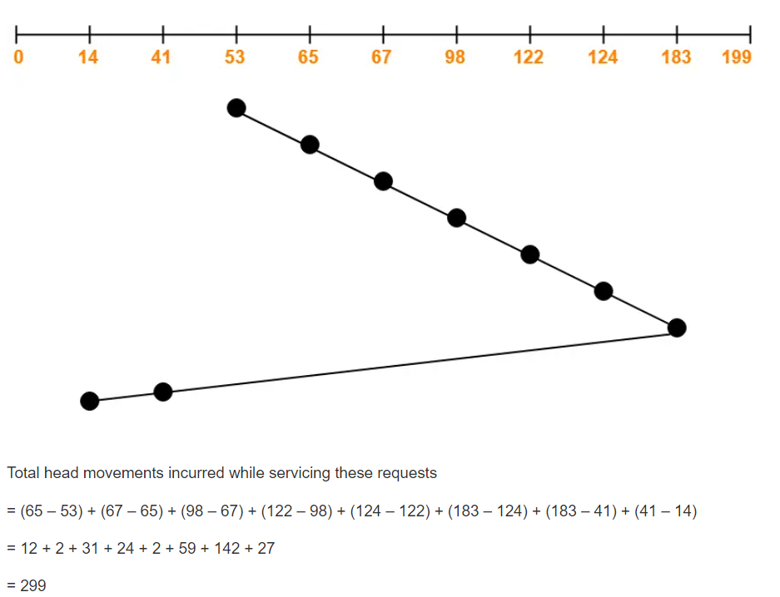

Slide 37
C-LOOK Disk Scheduling Algorithm-
Circular-LOOK Algorithm is an improved version of the LOOK Algorithm.
Head starts from the first request at one end of the disk and moves towards the last request at the other end servicing all the requests in between.
After reaching the last request at the other end, head reverses its direction.
It then returns to the first request at the starting end without servicing any request in between.
The same process repeats.

Slide 38
Advantages-
It does not causes the head to move till the ends of the disk when there are no requests to be serviced.
It reduces the waiting time for the cylinders just visited by the head.
It provides better performance as compared to LOOK Algorithm.
It does not lead to starvation.
It provides low variance in response time and waiting time.
Disadvantages-
There is an overhead of finding the end requests.

Slide 39
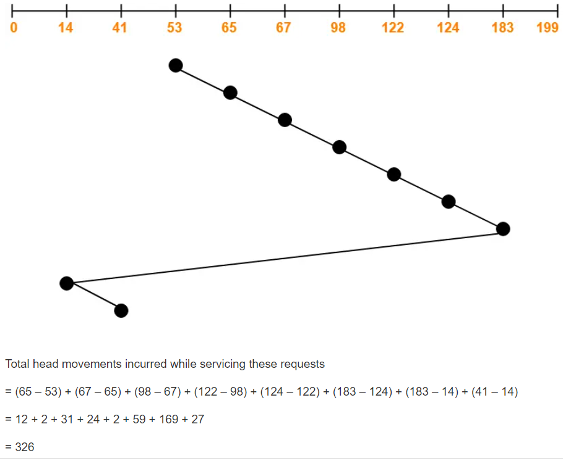

Slide 40
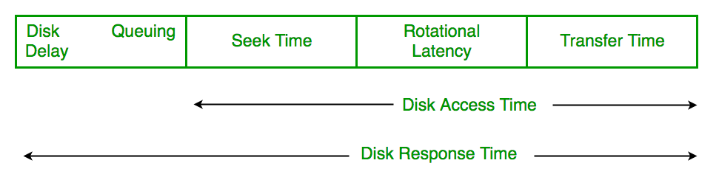
Disk arm Scheduling algorithms
FCFS (First Come First Serve)
SSTF (Shortest Seek Time First)
SCAN (Elevator Algorithm)
C-SCAN (Circular SCAN)
LOOK
C-LOOK

Slide 41
File Systems
Many important applications need to store more information then have in virtual address space of a process
The information must survive the termination of the process using it.
Multiple processes must be able to access the information concurrently.
Use file system as an abstraction to deal with accessing the information kept in blocks on a disk
Files are created by a process
Thousands of them on a disk
Managed by the OS
Disks are used to store files
Information is stored in blocks on the disks
Can read and write blocks

Slide 42
File Systems
OS structures them, names them, protects them
Two ways of looking at file system
User-how do we name a file, protect it, organize the files
Implementation-how are they organized on a disk
Start with user, then go to implementer

Slide 43
Naming
One to 8 letters in all current OS’s
Unix, MS-DOS (Fat16) file systems discussed
Fat (16 and 32) were used in first Windows systems
Latest Window systems use Native File System
All OS’s use suffix as part of name
Unix does not always enforce a meaning for the suffixes
DOS does enforce a meaning

Slide 44
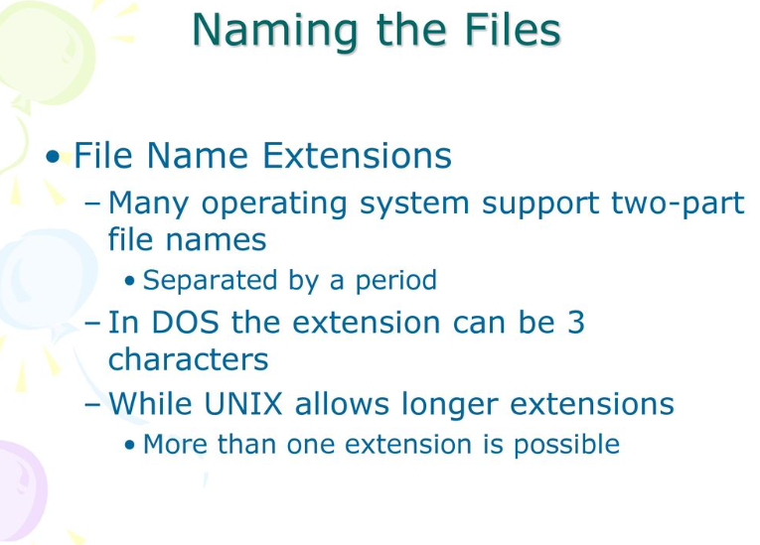
File Systems

Slide 45
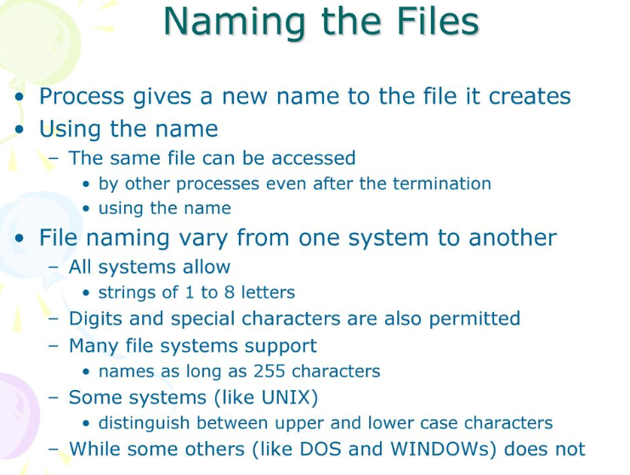
File Systems

Slide 46
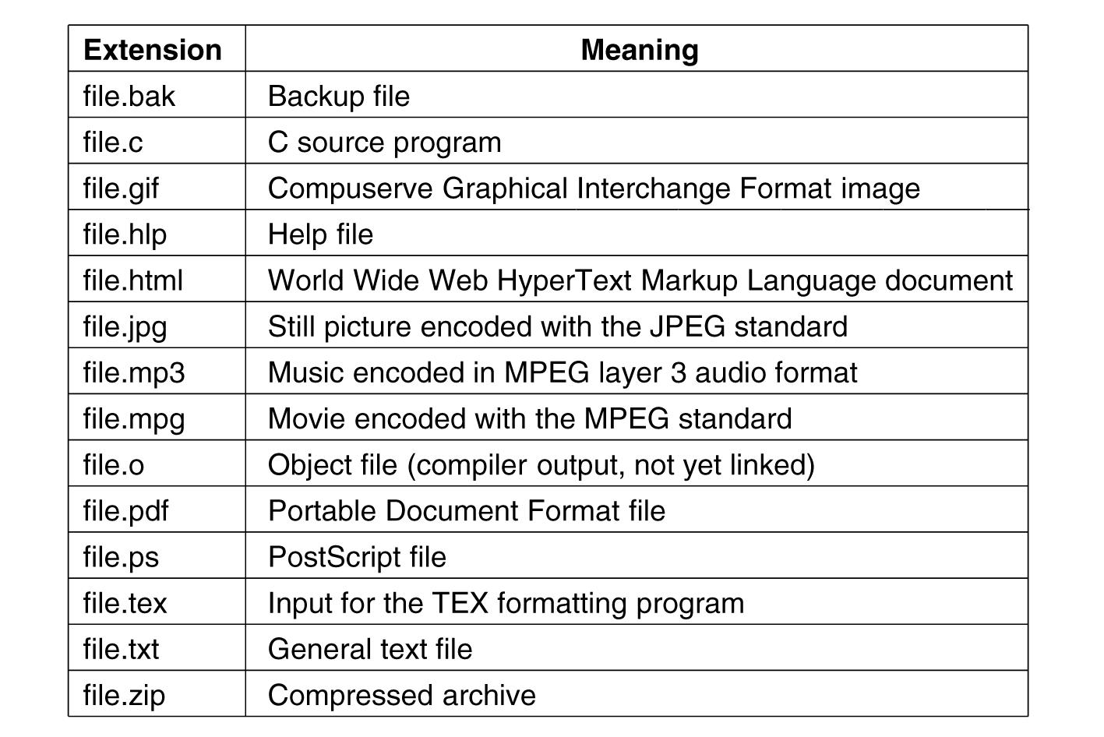
Suffix Examples
.

Slide 47
File Structure
Byte sequences
Maximum flexibility-can put anything in
Unix and Windows use this approach
Fixed length records (card images in the old days)
Tree of records- uses key field to find records in the tree

Slide 48
File Structure
Three kinds of files. (a) Byte sequence. (b) Record sequence. (c) Tree.
Tanenbaum, Modern Operating Systems 3 e, (c) 2008 Prentice-Hall, Inc. All rights reserved. 0-13-6006639

Slide 49
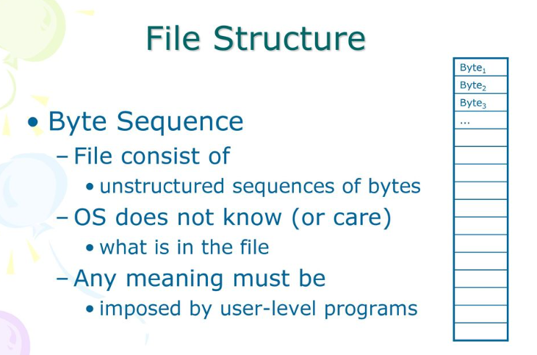
File Systems

Slide 50
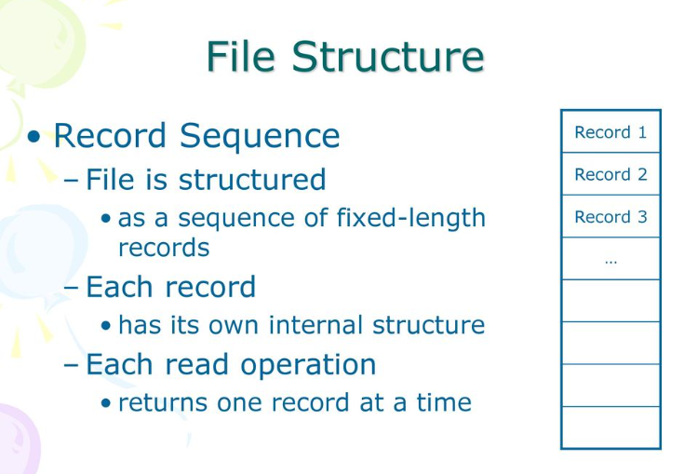
File Systems

Slide 51
File Types
Regular- contains user information
Directories- system files for maintaining the structure of the file system.
Character special files- model serial (e.g. printers) I/O devices
Block special files -model disks

Slide 52
Regular Files
ASCII or binary
ASCII
Printable
Can use pipes to connect programs if they produce/consume ASCII

Slide 53
Binary File Types
Two Unix examples
Executable (magic field identifies file as being executable)
Archive-compiled, not linked library procedures
Every OS must recognize its own executable

Slide 54
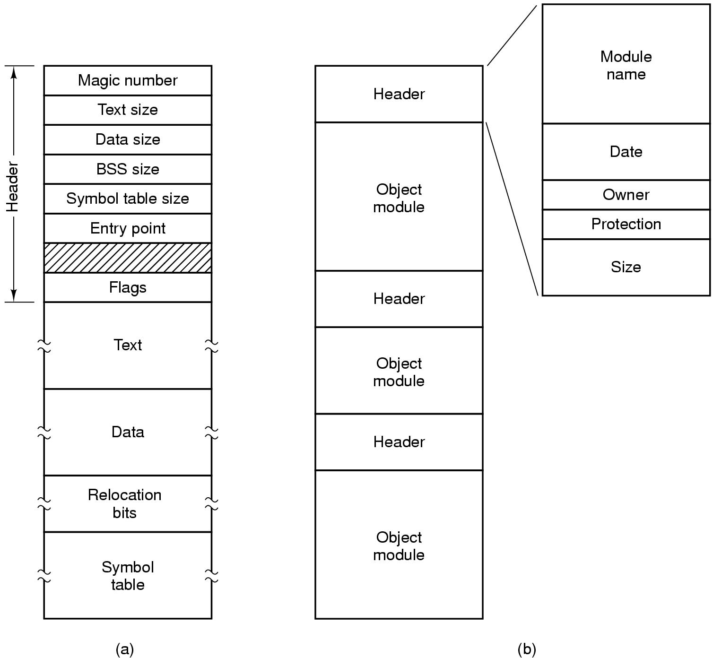
Binary File Types (Early Unix)
(b)An archive-library procedures compiled but not linked
Tanenbaum, Modern Operating Systems 3 e, ©
(a) An executable file (magic # identifiies it as an executable file)

Slide 55
File Access
Sequential access- read from the beginning, can’t skip around
Corresponds to magnetic tape
Random access- start where you want to start
read the bytes or records of a file out of order, or to access records by key rather than by position
Came into play with disks
Necessary for many applications, e.g. airline reservation system

Slide 56
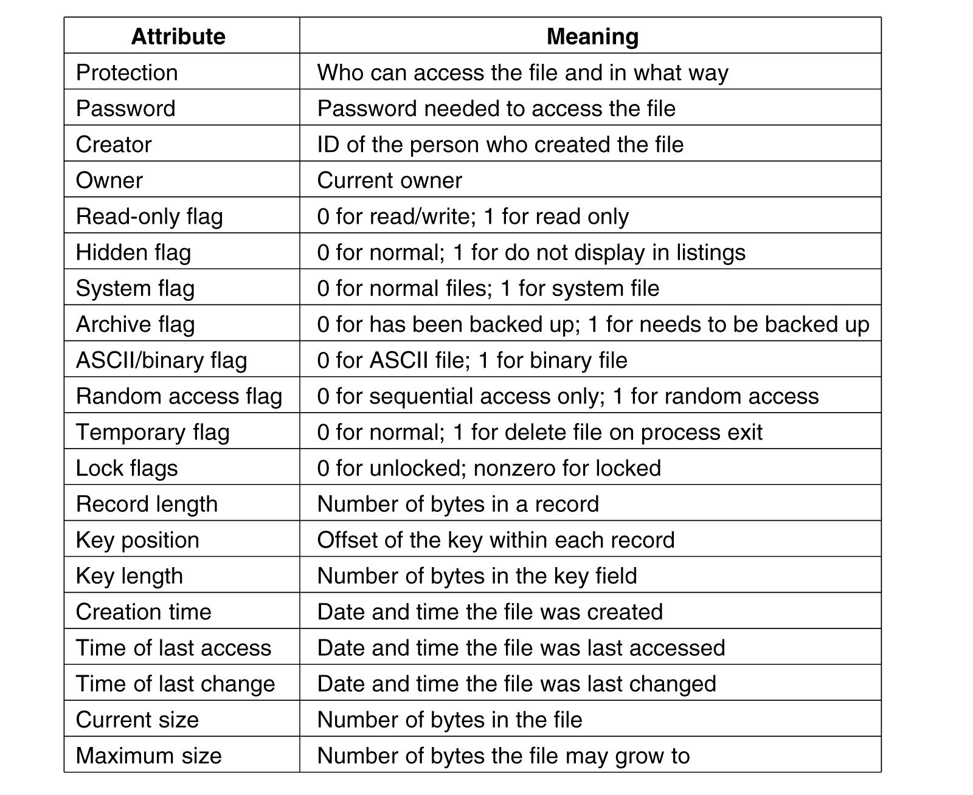
File Attributes (hypothetical OS)

Slide 57
System Calls for files
Create -with no data, sets some attributes
Delete-to free disk space
Open- after create, gets attributes and disk addresses into main memory
Close- frees table space used by attributes and addresses
Read-usually from current pointer position. Need to specify buffer into which data is placed
Write-usually to current position

Slide 58
System Calls for files
Append- at the end of the file
Seek-puts file pointer at specific place in file. Read or write from that position on
Get Attributes-e.g. make needs most recent modification times to arrange for group compilation
Set Attributes-e.g. protection attributes
Rename

Slide 59
How can system calls be used?
An example-copyfile abc xyz
Copies file abc to xyz
If xyz exists it is over-written
If it does not exist, it is created
Uses system calls (read, write)
Reads and writes in 4K chunks
Read (system call) into a buffer
Write (system call) from buffer to output file
Tanenbaum, Modern Operating Systems 3 e, (c) 2008 Prentice-Hall, Inc. All rights reserved. 0-13-6006639

Slide 60
Copyfile abc xyz
. . .
Figure 4-5. A simple program to copy a file.

Slide 61
Copyfile abc xyz (2)
.

Slide 62
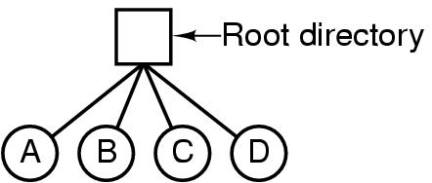
Single Level Directory Systems
Files which are used to organize a collection of files
Also called folders
A single-level directory system containing four files.
The advantages of this scheme are its simplicity and the ability to locate files quickly—there is only one place to look

Slide 63
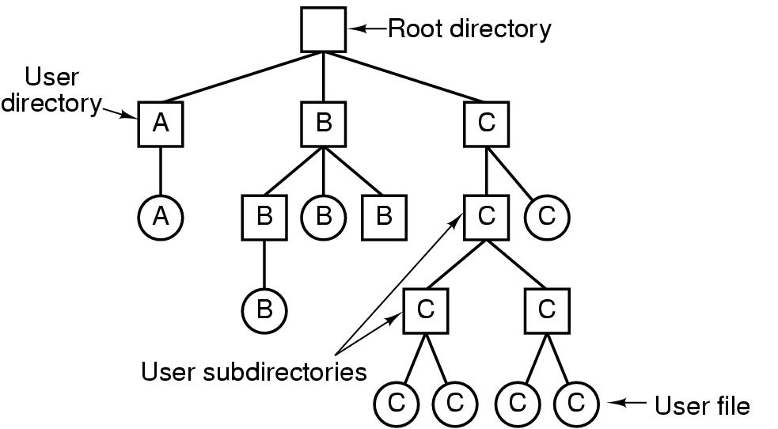
Hierarchical Directory Systems
A professor, for example, might have a
i)collection of files that together form a book that he is writing,
ii)a second collection containing student programs submitted for another course,
iii)a third group containing the code of an advanced compiler-writing system he is building,
iv)a fourth group containing grant proposals, as well as other files for electronic mail, minutes of meetings, papers he is writing, games, and so on

Slide 64
Path names
Absolute /usr/carl/cs310/miderm/answers
In the first method, each file is given an absolute path name consisting of the path from the root directory to the file.
As an example, the path /usr/ast/mailbox means that the root directory contains a subdirectory usr, which in turn contains a subdirectory ast, which contains the file mailbox. Absolute path names always start at the root directory and are unique.
Relative cs310/midterm/answers
. Refers to current (working) directory
.. Refers to parent of current directory

Slide 65
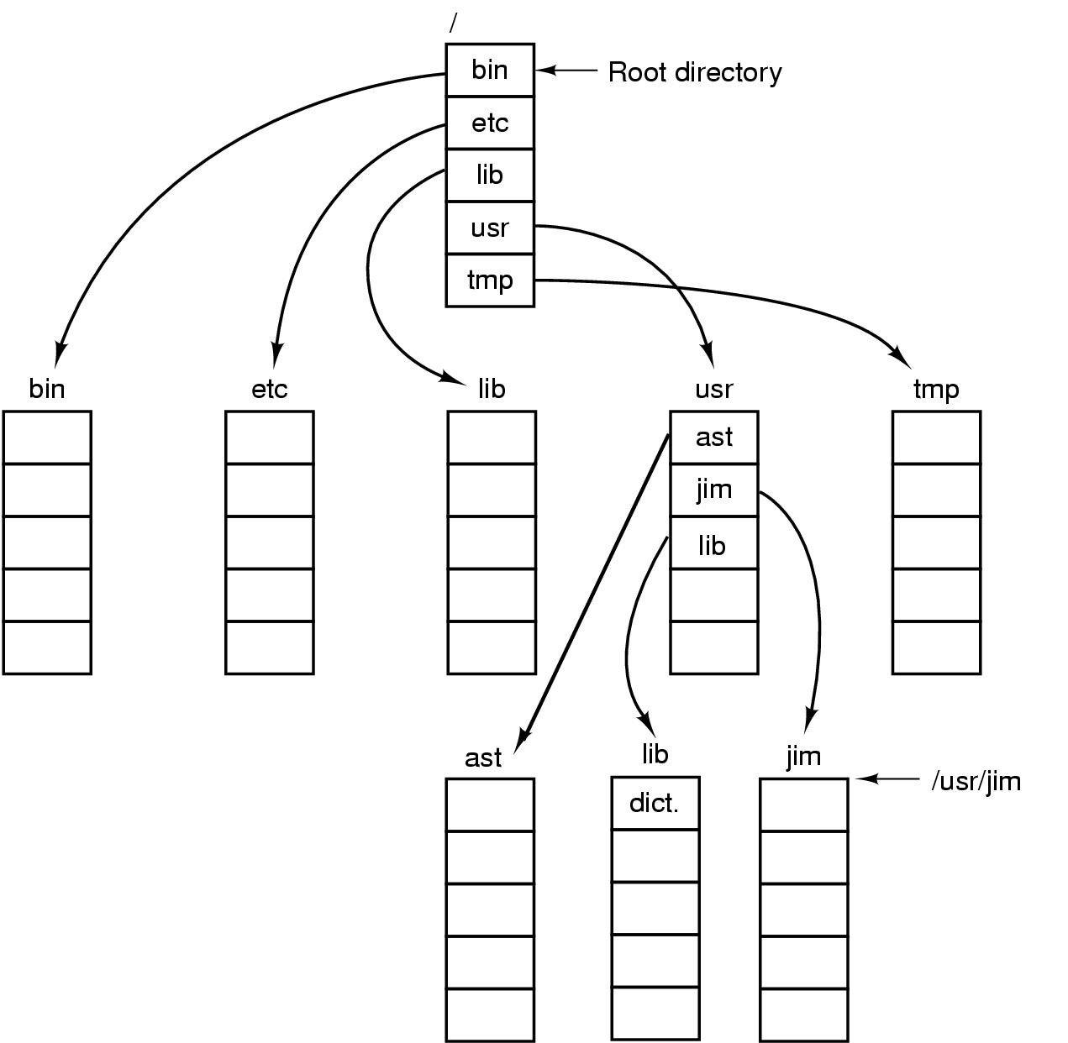
Path Names
A UNIX directory tree.

Slide 66
Unix cp commands involving dots
Cp ../lib/dictionary .
.. says go to parent (usr)
. says that target of the copy is current directory
cp /usr/lib/dictionary dictionary works
cp /usr/lib/dictionary /usr/ast/dictionary also works

Slide 67
Directory Operations
Create (Mkdir) creates directory
Delete directory has to be empty to delete it
Opendir Must be done before any operations on directory
Closedir
Readdir returns next entry in open directory
Rename
Link links file to another directory
Unlink Gets rid of directory entry

Slide 68
Directory Operations
System calls for managing directories (from Unix)
Readdir-reads next entry in open directory
Rename
Link-links file to path. File can appear in multiple directories!
Unlink-what it sounds like. Only unlinks from pathname specified in call

Slide 69
File Implementation
Files stored on disks. Disks broken up into one or more partitions, with separate fs on each partition
Sector 0 of disk is the Master Boot Record Used to boot the computer
End of MBR has partition table. Has starting and ending addresses of each partition.
One of the partitions is marked active in the master boot table
Boot computer => BIOS reads/executes MBR
MBR finds active partition and reads in first block (boot block)
Program in boot block locates the OS for that partition and reads it in
All partitions start with a boot block
Superblock contains info about the fs (e.g. type of fs, number of blocks, …)
i-nodes contain info about files
Tanenbaum, Modern Operating Systems 3 e, (c) 2008 Prentice-Hall, Inc. All rights reserved. 0-13-6006639

Slide 70
A Possible File System Layout

Slide 71
Allocating Blocks to files
Most important implementation issue
Methods
Contiguous allocation
Linked list allocation
Linked list using table
I-nodes

Slide 72
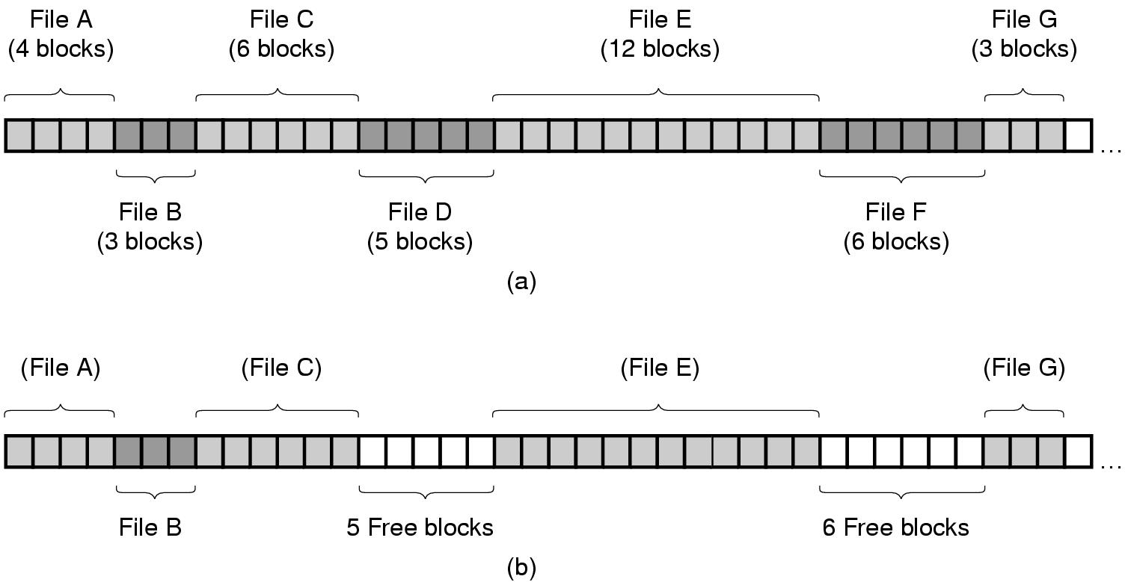
Contiguous Allocation
(a) Contiguous allocation of disk space for 7 files.
(b) The state of the disk after files D and F have been removed.
Tanenbaum, Modern Operating Systems 3 e, (c) 2008 Prentice-Hall, Inc. All rights reserved. 0-13-6006639

Slide 73
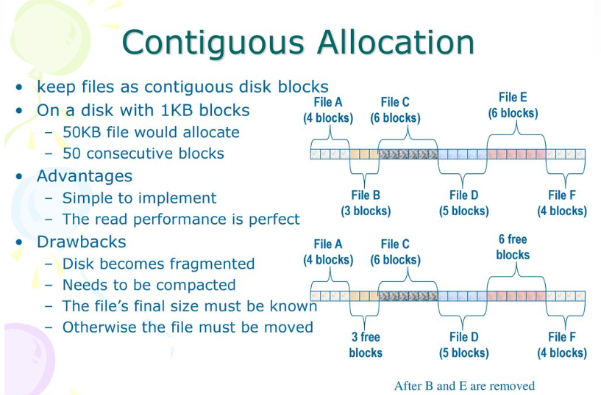
File Systems

Slide 74
Contiguous Allocation
The good
Easy to implement
Read performance is great. Only need one seek to locate the first block in the file. The rest is easy.
The bad-disk becomes fragmented over time
CD-ROM’s use contiguous allocation because the fs size is known in advance
DVD’s are stored in a few consecutive 1 GB files because standard for DVD only allows a 1 GB file max
Tanenbaum, Modern Operating Systems 3 e, (c) 2008 Prentice-Hall, Inc. All rights reserved. 0-13-6006639

Slide 75
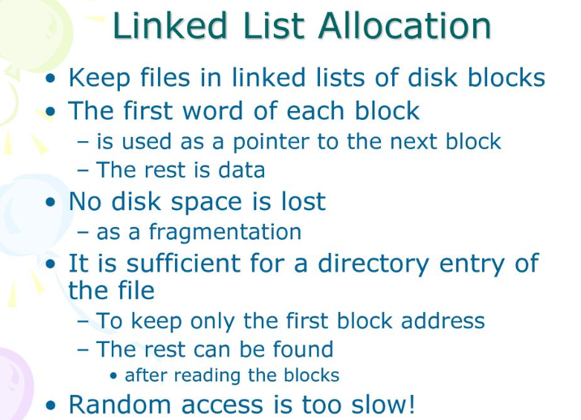
File Systems

Slide 76
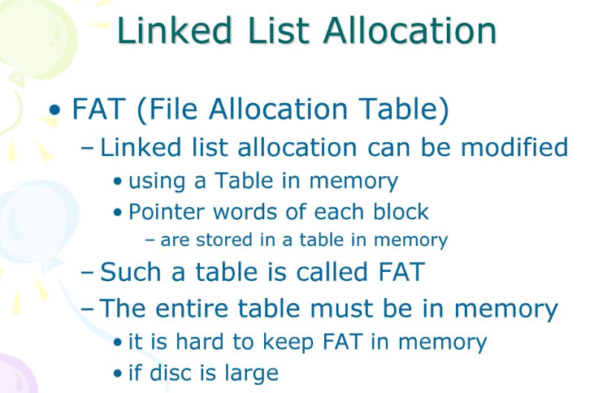
File Systems

Slide 77
Linked Lists
The good
Gets rid of fragmentation
The bad
Random access is slow. Need to chase pointers to get to a block
Both disadvantages of the linked-list allocation can be eliminated by taking the pointer word from each disk block and putting it in a table in memory.

Slide 78
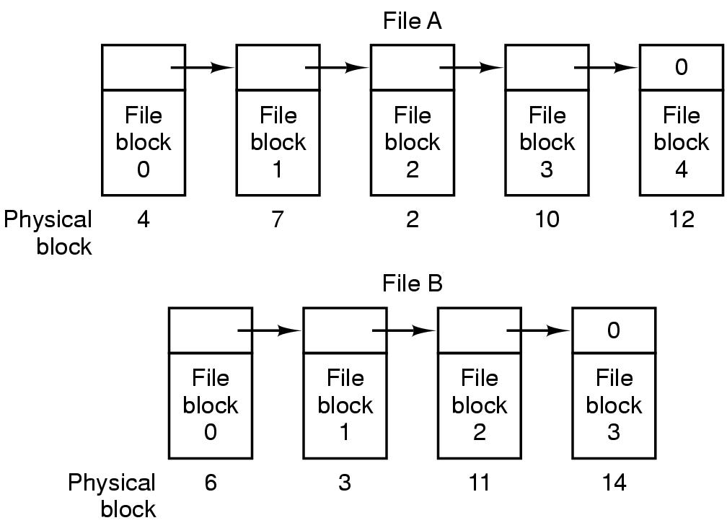
Linked List Allocation
Storing a file as a linked list of disk blocks.
Tanenbaum, Modern Operating Systems 3 e, (c) 2008 Prentice-Hall, Inc. All rights reserved. 0-13-6006639

Slide 79
Linked lists using a table in memory
Put pointers in table in memory
File A uses disk blocks 4, 7, 2, 10, and 12, in that order, and file B uses disk blocks 6, 3, 11, and 14, in that order.
Using the table of Fig. 4-12, we can start with block 4 and follow the chain all the way to the end. The same can be done starting with block 6. Both chains are terminated with a special marker (e.g., −1) that is not a valid block number.
Such a table in main memory is called a FAT (File Allocation Table)

Slide 80
The Solution-Linked List Allocation Using a Table in Memory
Figure 4-12. Linked list allocation using a file allocation table in main memory.

Slide 81
Linked lists using a table in memory
The bad-table becomes really big
E.g 200 GB disk with 1 KB blocks needs a 600 MB table
Growth of the table size is linear with the growth of the disk size
Tanenbaum, Modern Operating Systems 3 e, (c) 2008 Prentice-Hall, Inc. All rights reserved. 0-13-6006639

Slide 82
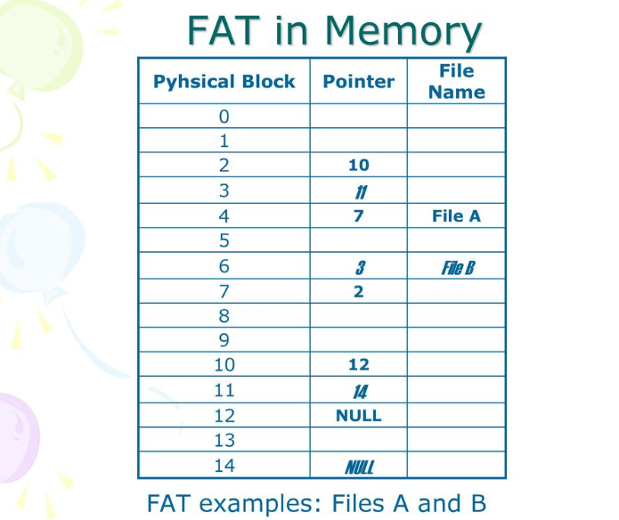
File Systems

Slide 83
I-nodes
Keep data structure in memory only for active files
Data structure lists disk addresses of the blocks and attributes of the files
K active files, N blocks per file => k*n blocks max!!
Solves the growth problem
The big advantage of this scheme over linked files using an in-memory table is that the i-node need be in memory only when the corresponding file is open.
If each I node occupies n bytes and a maximum of k files may be open at once, the total memory occupied by the array holding the i-nodes for the open files is only kn bytes. Only this much space need be reserved in advance.
How big is N?
Solution: Last entry in table points to disk block which contains pointers to other disk blocks

Slide 84
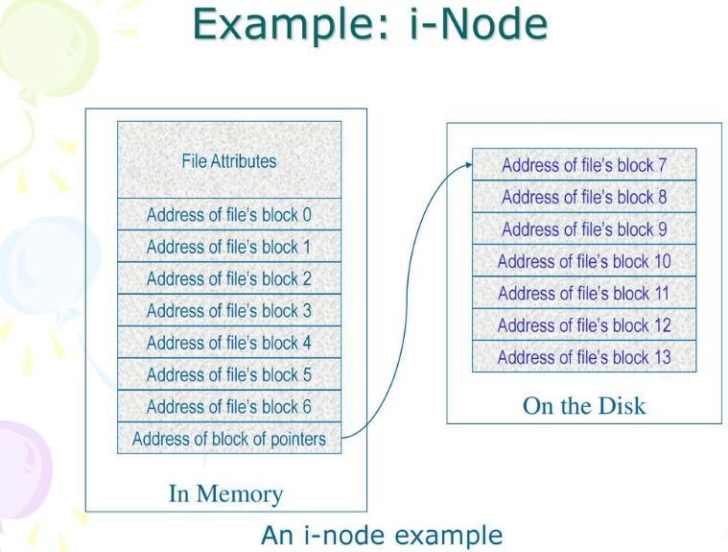
File Systems

Slide 85
Implementing Directories
Open file, path name used to locate directory
Directory specifies block addresses by providing
Address of first block (contiguous)
Number of first block (linked)
Number of i-node

Slide 86
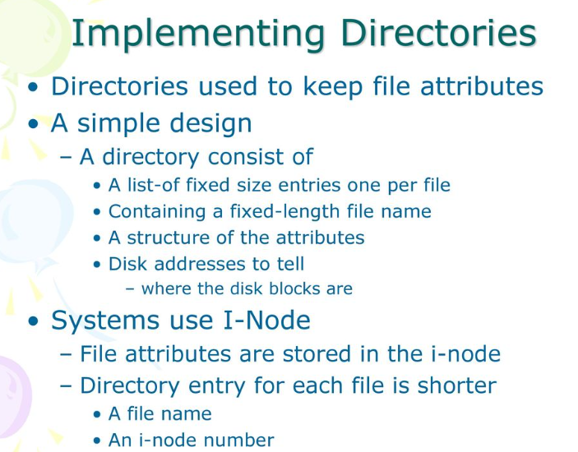
File Systems

Slide 87
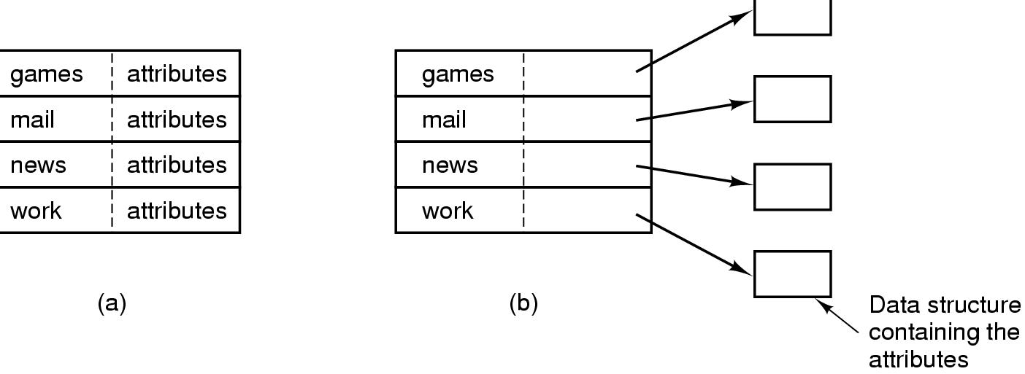
Implementing Directories
(a) fixed-size entries with the disk addresses and attributes (DOS) (b) each entry refers to an i-node. Directory entry contains attributes. (Unix)
Tanenbaum, Modern Operating Systems 3 e, (c) 2008 Prentice-Hall, Inc. All rights reserved. 0-13-6006639

Slide 88
Implementing Directories
How do we deal with variable length names?
Problem is that names have gotten very long
Two approaches
Fixed header followed by variable length names
Heap-pointer points to names
Tanenbaum, Modern Operating Systems 3 e, (c) 2008 Prentice-Hall, Inc. All rights reserved. 0-13-6006639

Slide 89
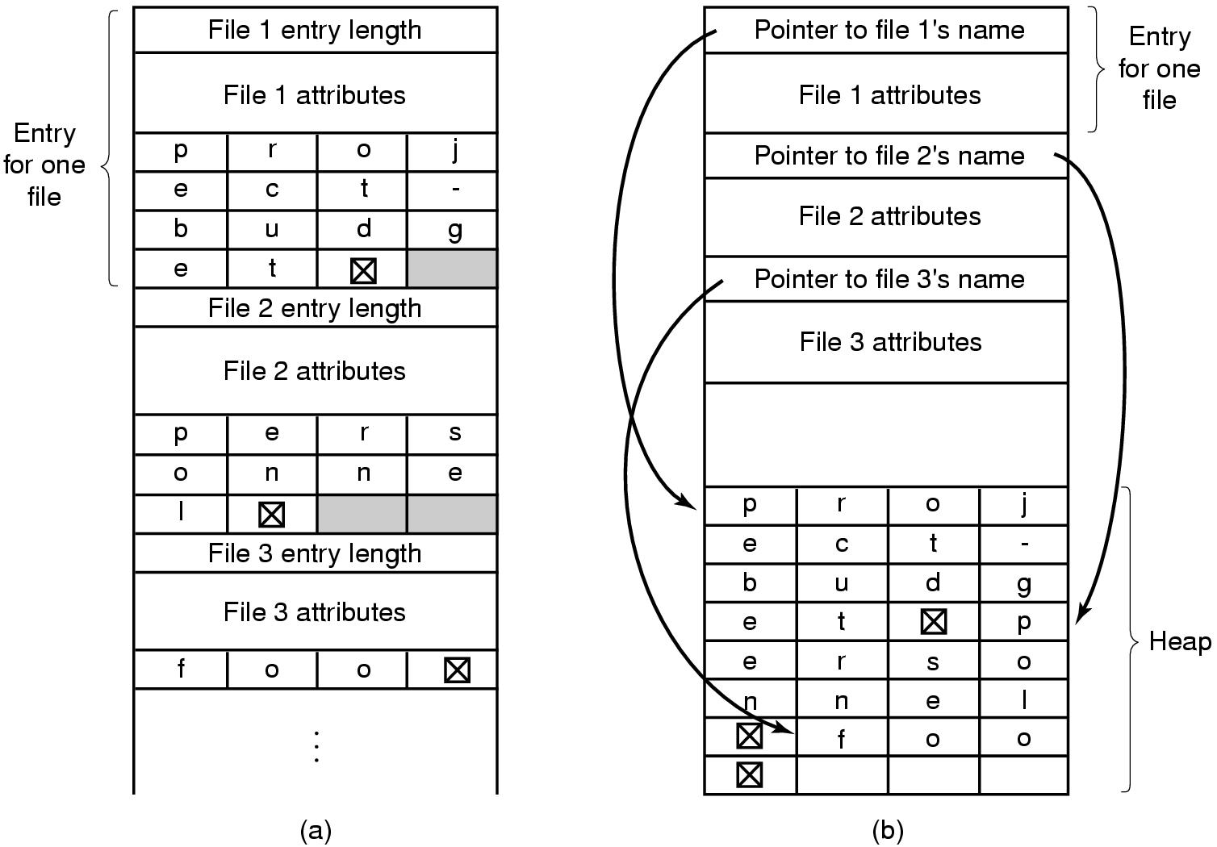
Implementing Directories
Two ways of handling long file names in a directory. (a) In-line. (b) In a heap.
Tanenbaum, Modern Operating Systems 3 e, (c) 2008 Prentice-Hall, Inc. All rights reserved. 0-13-6006639

